Slide 1

Welcome back! Link to Attendance Form ↓
bit.ly/a24-lec13

Slide 2

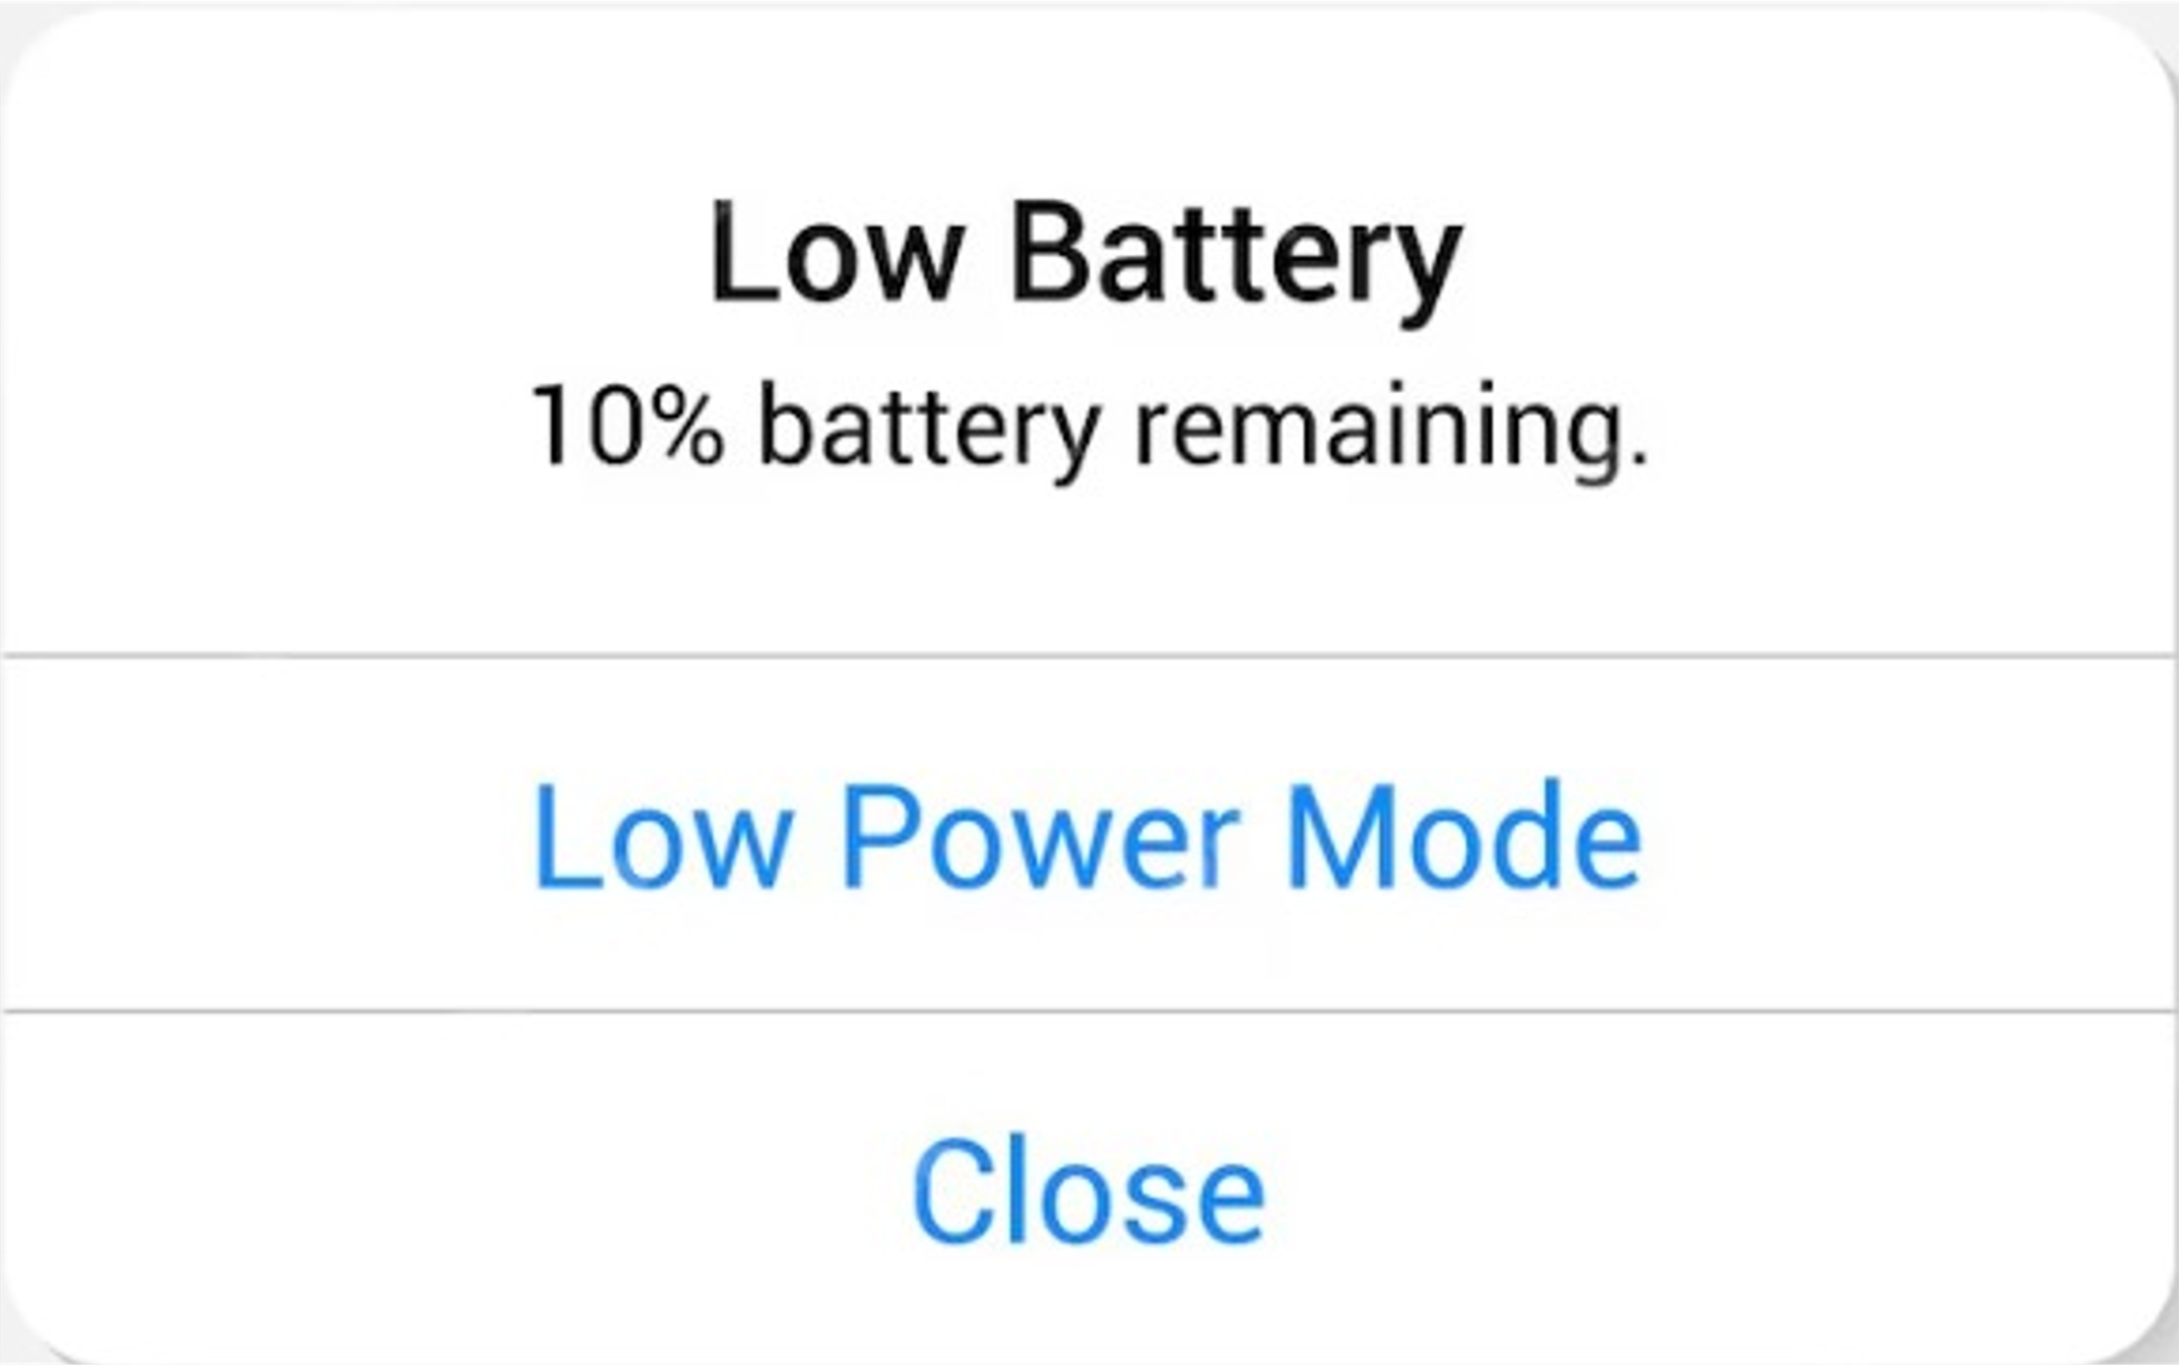

Slide 3


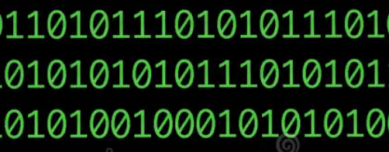
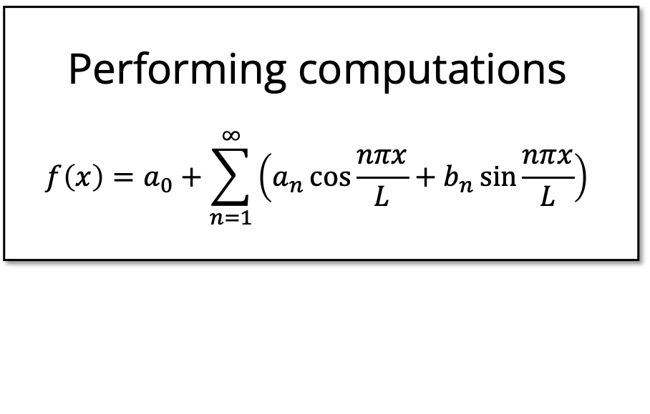
Things that drain battery life
Connecting to WiFi
Performing computations
$$f\left(x\right)=a_{0}+\sum_{n=1}^{∞}{\left(a_{n}\cos{\frac{nπx}{L}}+b_{n}\sin{\frac{nπx}{L}}\right)}$$
Powering the display
Copying data?? 🤔

Slide 4
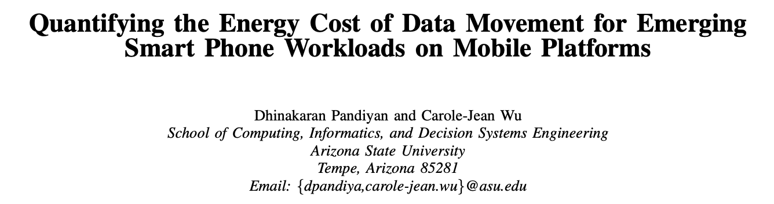
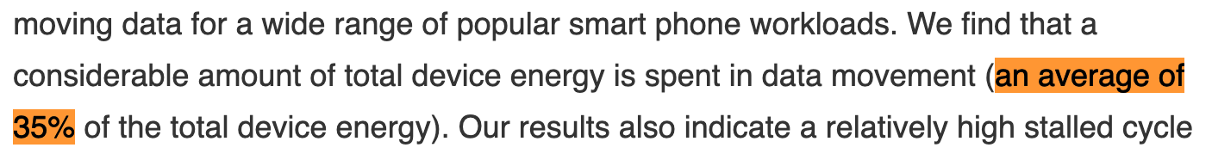
Copying data is expensive
[source]

Slide 5
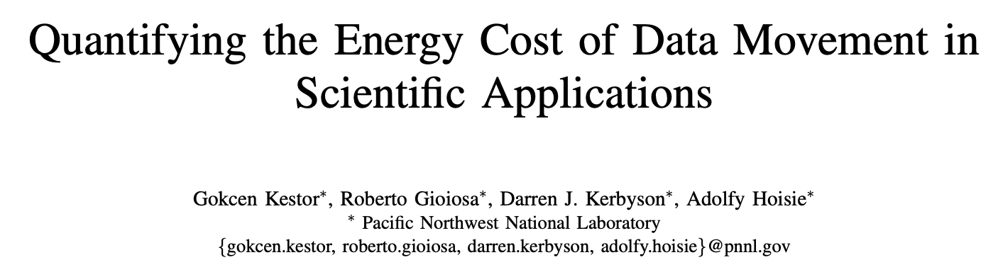
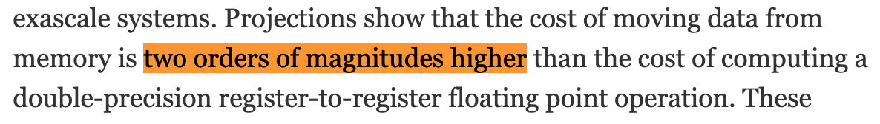
Copying data is expensive
[source]

Slide 6
Why does it matter?

Slide 7


Slide 8
How can we avoid needlessly copying data?

Slide 9
Lecture 13: Move Semantics
CS106L, Autumn 2024

Slide 10
Today’s Agenda
SMFs Recap
What is a special member function?
The Problem
How do our SMFs cause unnecessary copies?
lvalues and rvalues
How does C++ distinguish between persistent and temporary objects?
Move Semantics
How can we avoid making unnecessary copies? And a code demo!
std::move and SMFs
How can we ”opt-in” to move semantics? Which SMFs should I define?

Slide 11
SMFs Recap

Slide 12
Last Time
Special member functions handle the class lifecycle
Copy constructor Type::Type(const Type& other);
Copy assignment operator Type& Type::operator=(const Type& other);
Destructor Type::~Type();
Compiler creates these for us
But… if we’re managing memory, we need to override

Slide 13
Introducing… the Photo class
class Photo {
public:
Photo(int width, int height);
Photo(const Photo& other);
Photo& operator=(const Photo& other);
~Photo();
private:
int width;
int height;
int* data;
};

Slide 14
Photo Constructor
Photo::Photo(int width, int height)
: width(width)
, height(height)
, data(new int[width * height])
{}

Slide 15
Photo SMF: Copy Constructor
Photo::Photo(const Photo& other)
: width(other.width)
, height(other.height)
, data(new int[width * height])
{
std::copy(other.data, other.data + width * height, data);
}

Slide 16
Photo SMF: Copy Assignment
Photo &Photo::operator=(const Photo& other) {
// Check for self assignment
if (this == &other) return *this;
delete[] data; // Clean up old pixels!
// Copy over new pixels!
width = other.width;
height = other.height;
data = new int[width * height];
std::copy(other.data, other.data + width * height, data);
return *this;
}

Slide 17
Photo SMF: Destructor
Photo::~Photo()
{
delete[] data;
}

Slide 18
Your Turn
What special member functions get called at (A) and (B) below?
Photo takePhoto();
int main() {
Photo coolestSelfie = takePhoto(); // (A)
Photo retake(0, 0);
retake = takePhoto(); // (B)
}
Copy
Destruct
RVO
Assign
Destruct
RVO = Return Value Optimization (compiler optimization)

Slide 20
Your Turn
What happened?!
Photo takePhoto();
int main() {
Photo coolestSelfie = takePhoto(); // (A)
Photo retake(0, 0);
retake = takePhoto(); // (B)
}
Copy
Destruct
RVO
Assign
Destruct

Slide 21
The Problem

Slide 22
The Problem
📸
takePhoto()
retake = takePhoto();

Slide 23

The Problem
Photo
width = 3840
height = 2160
data = 0x1024c3bd
📸
takePhoto()
retake = takePhoto();

Slide 24
The Problem
Photo
width = 3840
height = 2160
data = 0x1024c3bd
Photo (retake)
width = 0
height = 0
data = 0x153713f1
📸
takePhoto()
retake = takePhoto(); // Copy assignment

Slide 25
The Problem
Photo
width = 3840
height = 2160
data = 0x1024c3bd
Photo (retake)
width = 3840
height = 2160
data = 0x133210f1
📸
takePhoto()
retake = takePhoto(); // Copy assignment

Slide 26
The Problem
☠️ Photo
width = 3840
height = 2160
data = 0x1024c3bd
Photo (retake)
width = 3840
height = 2160
data = 0x133210f1
📸
takePhoto()
retake = takePhoto(); // Destructor

Slide 27
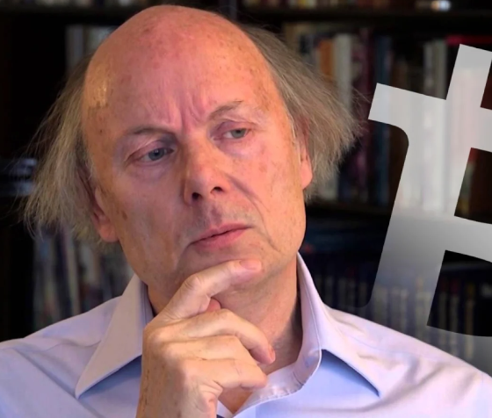
The Problem
concerned_bjarne

Slide 28
What if we could reuse the memory instead?

Slide 29
The Solution: Move Semantics
Photo
width = 3840
height = 2160
data = 0x1024c3bd
📸
takePhoto()

Slide 30
The Problem
Photo
width = 3840
height = 2160
data = 0x1024c3bd
Photo (retake)
width = 0
height = 0
data = 0x133210f1
📸
takePhoto()
retake = takePhoto(); // Move assignment

Slide 31
The Problem
Photo
width = 3840
height = 2160
data = 0x1024c3bd
Photo (retake)
width = 3840
height = 2160
data = 0x1024c3bd
📸
takePhoto()
retake = takePhoto(); // Copy Move assignment

Slide 32
The Problem
Photo
width = 3840
height = 2160
data = 0x0
Photo (retake)
width = 3840
height = 2160
data = 0x1024c3bd
📸
takePhoto()
nullptr
retake = takePhoto(); // Copy Move assignment

Slide 33
The Problem
☠️ Photo
width = 3840
height = 2160
data = 0x0
Photo (retake)
width = 3840
height = 2160
data = 0x1024c3bd
📸
takePhoto()
nullptr
retake = takePhoto(); // Destructor

Slide 34
We move takePhoto() because it’s temporary

Slide 35
Move vs. Copy Semantics
takePhoto() is temporary, so we can steal its resources!
Photo takePhoto();
int main() {
Photo retake(0,0);
retake = takePhoto(); // Move takePhoto()
// because it’s temporary!
}

Slide 36
Move vs. Copy Semantics
Is it always safe to move objects? Assume get_pixel accesses data
Photo takePhoto();
void foo(Photo whoAmI) {
Photo selfie = whoAmI; // What if we move here?
whoAmI.get_pixel(21, 24); // ???
}
What will happen if we try to run this code?

Slide 37
Move vs. Copy Semantics
❌ Since selfie stole whoAmI’s data, we end up dereferencing nullptr
Photo takePhoto();
void foo(Photo whoAmI) {
Photo selfie = whoAmI; // What if we move here?
whoAmI.get_pixel(21, 24); // ❌ use-after-move
}

Slide 38
Move vs. Copy Semantics
selfie1 = selfie2;
// copy persistent objects (e.g. variables)
retake = takePhoto();
// move temporary objects (e.g return values)
How does the compiler know whether to move or copy?

Slide 40
Move vs. Copy Semantics
selfie1 = selfie2;
// copy persistent objects (e.g. variables)
retake = takePhoto();
// move temporary objects (e.g return values)
How does the compiler know whether to move or copy?

Slide 41
lvalues & rvalues

Slide 42
lvalues & rvalues
lvalues and rvalues generalize the idea of “temporariness” in C++
pic is an lvalue!
void foo(Photo pic) {
Photo beReal = pic;
Photo insta = takePhoto();
}
takePhoto() is an rvalue!

Slide 43
lvalues & rvalues
lvalues have a definite address, rvalues do not!
pic is an lvalue!
We can take its address!
void foo(Photo pic) {
Photo* p1 = &pic;
Photo* p2 = &takePhoto(); // ❌ Doesn't work!
}
takePhoto() is an rvalue!
We cannot take its address!

Slide 44
An lvalue can appear on either side of an =
x = y;
y = 5;
An rvalue can appear only right of an =
x = 5;
5 = y;

Slide 45
Your Turn
Which of the following right hand assignments are rvalues?
Hint: which ones have a definite address?
int a = 4;
int& b = a;
vector<int> c = {1, 2, 3};
int d = c[1];
int* e = &c[2];
size_t f = c.size();
int g = static_cast<int>(f);
rvalue
lvalue
rvalue
lvalue
rvalue
rvalue
lvalue

Slide 46
An lvalue’s lifetime is until the end of scope
An rvalue’s lifetime is until the end of line

Slide 47
Quick Note: It’s more complicated than this!
expression
❌ Don’t Worry About This
glvalue
rvalue
lvalue
xvalue
prvalue

Slide 48
Working towards move semantics
If we have an lvalue, how can we avoid copying its memory?
void uploadToInsta(Photo pic);
int main() {
Photo selfie = takePhoto(); // selfie is lvalue
uploadToInsta(selfie); // 🤦 Unnecessary copy is made here
}

Slide 49
Working towards move semantics
We can pass by reference! 🥳
void uploadToInsta(Photo& pic);
int main() {
Photo selfie = takePhoto(); // selfie is lvalue
uploadToInsta(selfie); // ✅ No copy is made here
}

Slide 50
Working towards move semantics
How can we avoid copying rvalues?
What happens if we try to pass by reference?
void uploadToInsta(Photo& pic);
int main() {
uploadToInsta(takePhoto()); // Does this work?
}
❌ candidate function not viable: expects lvalue as 1st argument

Slide 51
How do we avoid copying rvalues?
thinking_bjarne

Slide 52
lvalue reference
rvalue reference
void upload(Photo& pic);
int main() {
Photo selfie = takePhoto();
upload(selfie);
}
void upload(Photo&& pic);
int main() {
upload(takePhoto());
}
We can do whatever we want with Photo&& pic, it’s temporary!

Slide 53
A few important points
lvalue references
Syntax: Type&
Persistent, must keep object in valid state after function terminates
rvalue references
Syntax: Type&&
Temporary, we can steal (move) its resources
Object might end up in an invalid state, but that’s okay! It’s temporary!

Slide 54
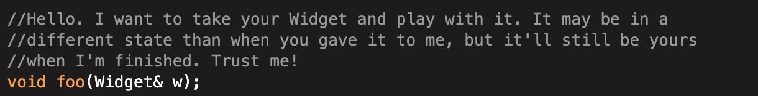
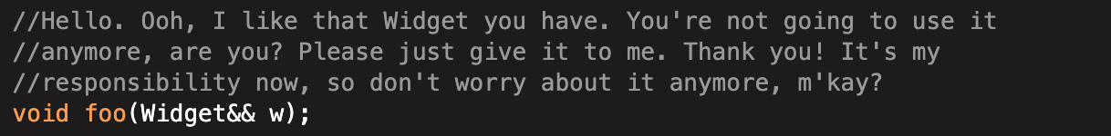
[source]

Slide 55
Key Idea: Overloading & and && parameters distinguish lvalue and rvalue references

Slide 56
lvalue/rvalue overloading
void upload(Photo& pic);
int main() {
Photo selfie = takePhoto();
upload(selfie);
}
void upload(Photo&& pic);
int main() {
upload(takePhoto());
}
Compiler decides which version of upload to call depending on whether argument is lvalue or rvalue!

Slide 58
Move Semantics

Slide 59
What we want!
Photo selfie1 = selfie2;
// copy persistent objects (e.g. variables)
retake = takePhoto();
// move temporary objects (e.g return values)
Photo&
Photo&&

Slide 60
Let’s overload the special member functions!
Copy constructor
Move constructor
Photo::Photo(const Photo& other)
: width(other.width)
, height(other.height)
, data(new int[width * height])
{
std::copy(
other.data,
other.data + width * height,
data
);
}
Photo::Photo(Photo&& other)
: width(other.width)
, height(other.height)
{
// other is temporary
// Let’s steal its
// resources since we know
// it’s about to be gone!
}

Slide 61
Let’s overload the special member functions!
Copy assignment operator
Move assignment operator
Photo& Photo::operator=(const Photo& other) {
if (this == &other) return *this;
delete[] data;
width = other.width;
height = other.height;
data = new int[width * height];
std::copy(other.data, other.data + width * height, data);
return *this;
}
Photo&
Photo::operator=(Photo&& other)
{
// other is temporary
// Let’s steal its
// resources since we know
// it’s about to be gone!
}

Slide 62
Let’s code this up!

Slide 63
106l.vercel.app/movesem

Slide 64
Two new special member functions!
Move constructor
Type::(Type&& other)
Move assignment operator
Type& Type::operator=(Type&& other)

Slide 66
std::move and SMFs

Slide 67
Forcing Move Semantics
Usually, we let the compiler decide between & and &&
Is that always the most efficient choice?
E.g. what if we know that an lvalue will never be used again?

Slide 68
Forcing Move Semantics
Line 3 copies each element into its new spot, even though the original value is never used again
1 void PhotoCollection::insert(const Photo& pic, int pos) {
2 for (int i = size(); i > pos; i--)
3 elems[i] = elems[i – 1]; // Shuffle elements down
4 elems[i] = pic;
5 }

Slide 69
Forcing Move Semantics
Solution: use move semantics
1 void PhotoCollection::insert(const Photo& pic, int pos) {
2 for (int i = size(); i > pos; i--)
3 elems[i] = std::move(elems[i – 1]);
4 elems[i] = pic;
5 }
std::move casts an lvalue to an rvalue, allowing compiler to select correct overload

Slide 70
Be wary of std::move
If we move an lvalue, what happens to it afterwards?
Photo takePhoto();
void foo(Photo whoAmI)
Photo selfie = std::move(whoAmI);
whoAmI.get_pixel(21, 24); // ???
}
❌ If we move, whoAmI ends up in an unknown state!

Slide 71
Use std::move to implement move operations!
class Photo {
public:
Photo::Photo(Photo&& other) {
keywords = other.keywords;
}
private:
std::vector<string> keywords;
};
We know that other is temporary! So do we really need to make a copy of other.keywords?

Slide 72
Use std::move to implement move operations!
class Photo {
public:
Photo::Photo(Photo&& other) {
keywords = std::move(other.keywords);
}
private:
std::vector<string> keywords;
};
Solution: force move semantics by using std::move

Slide 73
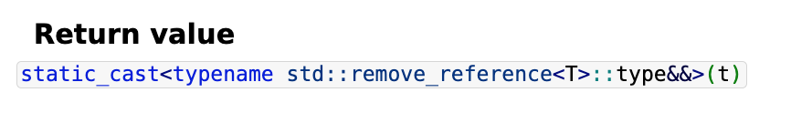
std::move doesn’t do anything special!
std::move just type casts an lvalue to an rvalue
Like const_cast, we ”opt in” to potentially error-prone behaviour
What if we try to use an object after it’s been moved! 🚨🆘🚨
Try to avoid explicitly using std::move unless you have good reason!
E.g. performance really matters, you know for sure the object won’t be used!

Slide 75
We have two new SMFs!
Type::Type(const Type& other);
Type& Type::operator=(const Type& other);
Type::Type(Type&& other);
Type& Type::operator=(Type&& other);
~Type::Type();

Slide 76
So many SMFs… 😩 Do I need to define them all!?

Slide 77
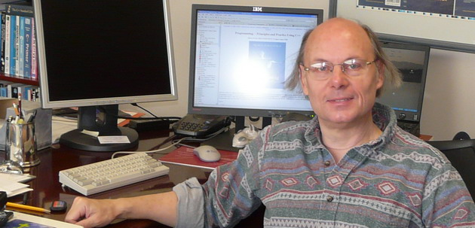
No! Rule of zero, three, and five!

Slide 78
Rule of Zero
If a class doesn’t manage memory (or another external resource), the compiler generated versions of the SMFs are sufficient!
Example: Compiler generated SMFs of Post will call SMFs of Photo and std::string
struct Post {
Photo photo;
std::string user;
};

Slide 79
Rule of Three
If a class manages external resources, we must define copy assignment/constructor
If we don’t, compiler-generated SMF won’t copy underlying resource
This will lead to bugs, e.g. two Photo’s referring to the same underlying data
Rule of Three: If you need any one of these, you need them all:
Destructor
Copy Assignment
Copy Constructor

Slide 80
Rule of Five
If we defined copy constructor/assignment and destructor, we should also define move constructor/assignment
This is not required, but our code will be slower as it involves unnecessary copying
Rule of Five: If you need any of these, you probably want them all:
Destructor
Copy Assignment
Copy Constructor
Move Assignment (Optional)
Move Constructor (Optional)

Slide 82
Recap

Slide 83
What we covered
SMFs Recap
SMFs manage the lifetime of a class instance.
The Problem
The copy SMFs make a copy of every object, including temporary ones!
lvalues and rvalues
An lvalue is a persistent object. An rvalue is a temporary one.
Move Semantics
We can define “move” overloads of the copy constructor/assignment operator
std::move and SMFs
std::move opts into move semantics, but be careful! Rule of zero/three/five

